Slide 1
Distributed System Design:
An Overview*
Jie Wu
Department of Computer Science and Engineering
Florida Atlantic University
Boca Raton, FL 33431
U.S.A.
*Part of the materials come from Distributed System Design, CRC Press, 1999.
(Chinese Edition, China Machine Press, 2001.)

Slide 2
Development of Computer Technology
1950s: serial processors
1960s: batch processing
1970s: time-sharing
1980s: personal computing
1990s: parallel, network, and distributed processing
2000s: wireless networks and mobile computing?

Slide 3
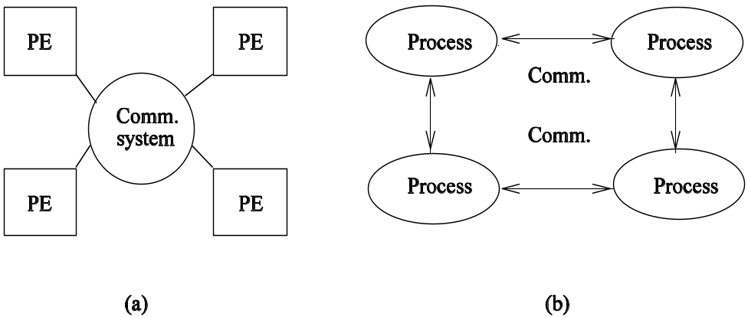
A Simple Definition
A distributed system is a collection of independent computers that appear to the users of the system as a single computer.
Distributed systems are "seamless": the interfaces among functional units on the network are for the most part invisible to the user.
System structure from the physical (a) or logical point of view (b).

Slide 4
Motivation
People are distributed, information is distributed (Internet and Intranet)
Performance/cost
Information exchange and resource sharing (WWW and CSCW)
Flexibility and extensibility
Dependability

Slide 5
Two Main Stimuli
Technological change
User needs

Slide 6
Goals
Transparency: hide the fact that its processes and resources are physically distributed across multiple computers.
  Access
  Location
  Migration
  Replication
  Concurrency
  Failure
  Persistence
Scalability: in three dimensions
  Size
  Geographical distance
  Administrative structure

Slide 7
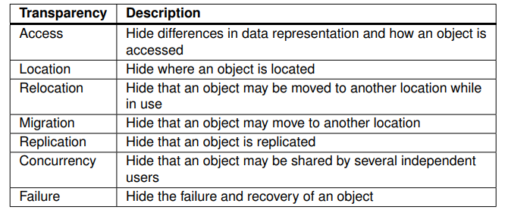
Goals

Slide 8
Goals
Scalability: in three dimensions
  Size :A system can be scalable with respect to its size, meaning
  that we can easily add more users and resources to the system without
  any noticeable loss of performance.
  Geographical distance: A geographically scalable system is one in which
  the users and resources may lie far apart, but the fact that communication
  delays may be significant is hardly noticed
  Administrative structure: An administratively scalable system is one that
  can still be easily managed even if it spans many independent administrative organizations.

Slide 9
Goals (Cont’d.)
Heterogeneity (mobile code and mobile agent)
  Networks
  Hardware
  Operating systems and middleware
  Program languages
Openness: essentially a system that offers components that can easily be used by, or integrated into other systems.
Security
Fault Tolerance
Concurrency

Slide 10
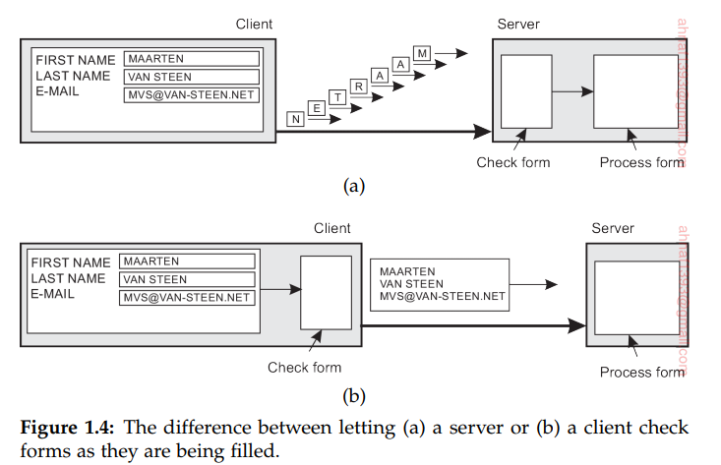
Scaling Techniques
Latency hiding (pipelining and interleaving execution)
  try to avoid waiting for responses to remote-service requests as much as possible. For example, when a service has been requested at a remote machine, an alternative to waiting for a reply from the server is to do other useful work at the requester’s side

Slide 11
Scaling Techniques
Latency hiding (pipelining and interleaving execution)
  try to avoid waiting for responses to remote-service requests as much as possible. For example, when a service has been requested at a remote machine, an alternative to waiting for a reply from the server is to do other useful work at the requester’s side
Distribution (spreading parts across the system)
Replication (caching): not only increases availability, but also helps to balance the load between components

Slide 12
Example 1: (Scaling Through Distribution)
URL searching based on hierarchical DNS name space (partitioned into zones).
DNS name space.

Slide 13
Design Requirements
Performance Issues
  Responsiveness
  Throughput
  Load Balancing
Quality of Service
  Reliability
  Security
  Performance
Dependability
  Correctness
  Security
  Fault tolerance

Slide 14
Similar and Related Concepts
Distributed
Network
Parallel
Concurrent
Decentralized

Slide 15
Focus 1: Enslow's Definition
Distributed system = distributed hardware + distributed control + distributed data
A system could be classified as a distributed system if all three categories (hardware, control, data) reach a certain degree of decentralization.

Slide 16
Focus 1 (Cont’d.)
Enslow's model of distributed systems.

Slide 17
Network Systems
Performance scales on throughput (transaction response time or number of transactions per second) versus load.
Work on burst mode.
Suitable for small transaction-oriented programs (collections of small, quick, distributed applets).
Handle uncoordinated processes.

Slide 18
Focus 2: Different Viewpoints
Architecture viewpoint
Interconnection network viewpoint
Memory viewpoint
Software viewpoint
System viewpoint

Slide 19
Architecture Viewpoint
Multiprocessor: physically shared memory structure
Multicomputer: physically distributed memory structure.

Slide 20
Interconnection Network Viewpoint
static (point-to-point) vs. dynamics (ones with switches).
bus-based (Fast Ethernet) vs. switch-based (routed instead of broadcast).

Slide 21
Memory Viewpoint
Physically versus logically shared/distributed memory.

Slide 22
Software Viewpoint
Distributed systems as resource managers like traditional operating systems.
  Multiprocessor/Multicomputer OS
  Network OS
  Middleware (on top of network OS)

Slide 23
Middleware
Middleware

Slide 24
System Viewpoint
The division of responsibilities between system components and placement of the components.

Slide 25
Key Issues (Stankovic's list)
Theoretical foundations
Reliability
Privacy and security
Design tools and methodology
Distribution and sharing
Accessing resources and services
User environment
Distributed databases
Network research

